Slide 1


































THE MOST EFFICIENT & EASY NATIONAL MAGAZINE OFFER TO REACH THE LARGEST MAGAZINE AUDIENCE

Slide 2
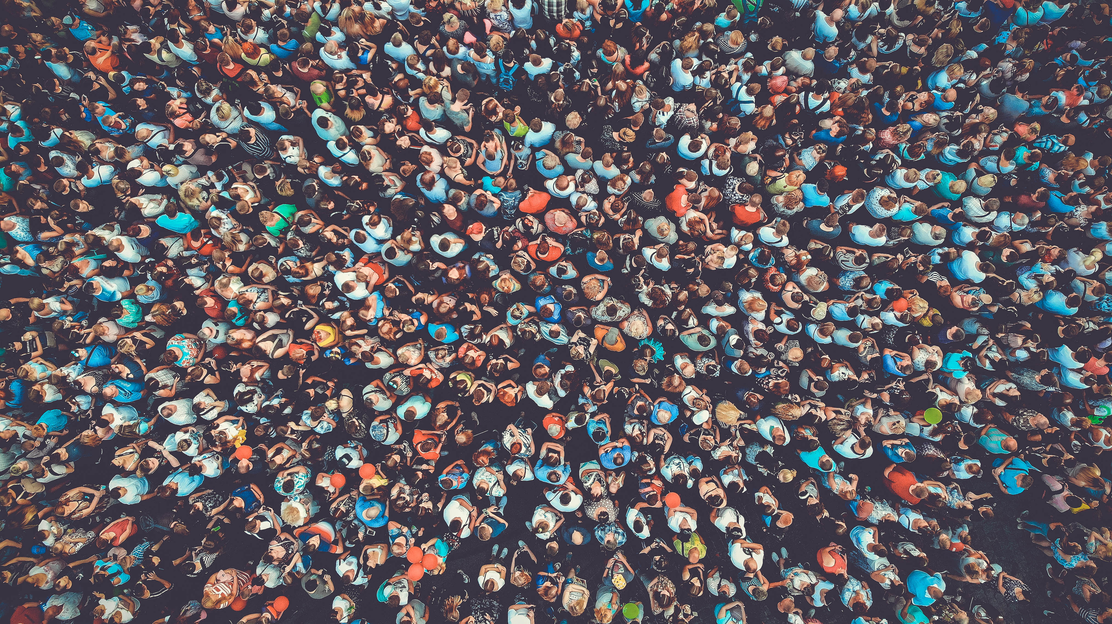



Reach
1 out of 2
Belgians
MAGIXX REACH
PRINT VERSIONS
Libelle | Femmes d'Aujourd‘hui | Knack | Le Vif/L'Express |
Dag Allemaal | HUMO | Soir Mag | Ciné Télé Revue | Moustique
€ 39 000* (Brut: € 106.961) 1x 1/1p in each of the magazines
Reach | 2 943 780
Contacts (MPX) | 6,4 M
Cost/1,000 MPX | € 6,09
Discount | 64 %
€ 83 500* (Brut: € 320.883) 3x 1/1p in each of the magazines
Reach | 4 094 080
Contacts (MPX) | 19,2 M
Cost/1,000 MPX | € 4,35
Discount | 74 %
* Net net rates - Survey: CIM Press Audience Study 2024 EN - Target Group: 16+

Slide 3




MAGIXX WOMEN
PRINT VERSIONS
Flair NL | Flair FR | nina | Telepro|
Feeling | GAEL | Goed Gevoel | Paris Match
€ 35 000* (Brut: € 73.220) 1x 1/1p in each of the magazines
Reach Women | 1 025 360
Contacts (MPX) Women | 1,97 M
Selectivity Women | 123,8
Cost/1,000 MPX Women | € 17,7
Discount | 52 %
€ 50 000* (Brut: € 156.494) 3x 1/1p in each weekly magazine 1x 1/1p in each monthly magazine
Reach Women | 1 580 810
Contacts (MPX) Women | 5,9 M
Selectivity Women | 124,3
Cost/1,000 MPX Women | € 8,47
Discount | 68 %
* Net net rates - Survey: CIM Press Audience Study 2025 EN - Target Group: Women 16+

Slide 4
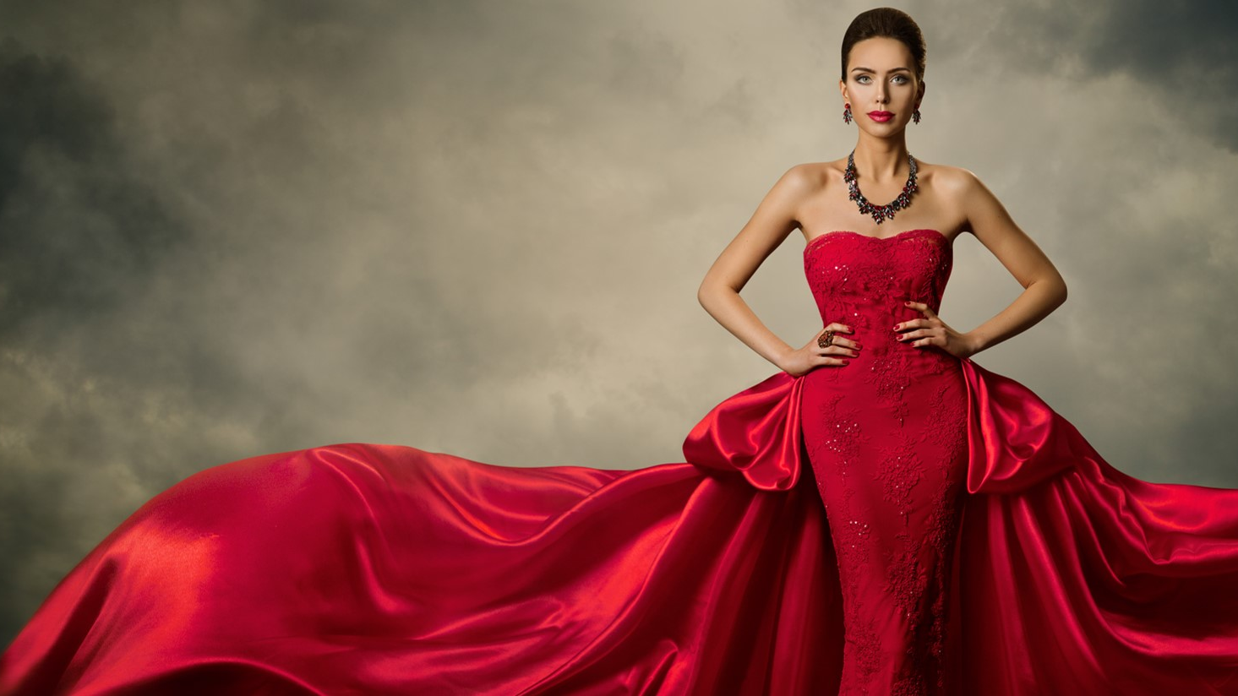



MAGIXX LUXE
PRINT VERSIONS
Knack Weekend | Le Vif Weekend | So Soir | Magazine |
Feeling| Stijlvol Wonen | Paris Match
€ 35 000* (Brut: € 67.657) 1x 1/1p in each of the magazines
Reach | 315 329
Contacts (MPX) SG 1-2 | 540 491
Selectivity SG 1-2 | 119,5
Cost/1,000 MPX SG 1-2 | € 64,75
Discount | 48 %
€ 50 000* (Brut: € 118.709) 2x 1/1p in each weekly magazine 1x 1/1p in each monthly magazine
Reach Social Groups 1-2 | 436 520
Contacts (MPX) SG 1-2 | 1,1M
Selectivity SG 1-2 | 120,1
Cost/1,000 MPX SG 1-2 | € 45,45
Discount | 58 %
* Net net rates - Survey: CIM Press Audience Study 2025 EN - Target Group: Sg1-2

Slide 5

MAGIXX PACKAGES IN A NUTSHELL
1 insertion | 3 insertions | 1 insertion | 3 insertions | 1 insertion | 2 insertions
€ 39 000 Reach 16+ : 2,9M | € 83 500 Reach 16+ : 4,1M | € 35 000 Reach women : 1M | € 50 000 Reach women : 1,6 M | € 35 000 Reach SG 1-2 : 315K | € 50 000 Reach SG 1-2 : 436K
€ 13 800* 1week Skins + IMU Impres. 1,38 M
€ 27 000* 3 weeks Skins + IMU Impres. 2,7 M
Libelle (.be) | Femmes d'Aujourd‘hui (.be) | Knack (.be) | Le Vif(.be) | HUMO (.be) | Soir Mag (.be) | Ciné Télé Revue (.be) |(hln.be/showbizz) | Moustique(.be) | Parismatch (.be)
PRINT
DIGITAL*
* Only in combination with print

Slide 6

CONTACT US !
FABIENNE DEWILDE
0475 49 66 24
Fabienne.dewilde@roularta.be
CHRISTEL SANDERS
0479 97 06 56
christel.sanders@dpgmedia.be
LAURENCE DE PELSEMAEKER
0479 49 95 24
ldp@rossel.be
NADINE MORREN
0475 31 50 76
nadine.morren@ipmgroup.be

